Slide 1
Notes:
DON’T FORGET TO START DATABRICKS CLUSTER!!!!!

Slide 2
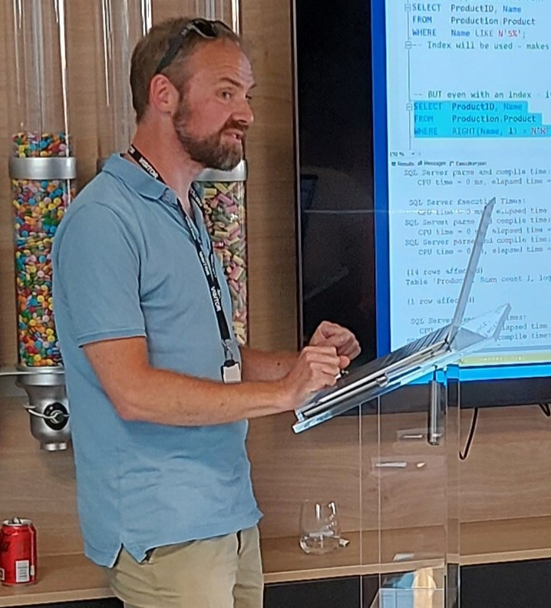

Phil Austin
Senior Consultant

Slide 3
Azure
Go to Azure.com
Click ‘Try Azure for free’
You will need:
An email address
A mobile phone
A credit/debit card – don’t worry you won’t be charged!
Choose United Kingdom or US region
$200 credit / 30 days
Some resources are free longer / permanently

Slide 4

Data engineering using your free credits
SQL Server
Resource group

Slide 5

Data engineering using your free credits
SQL Server
Data Factory
Resource group

Slide 6

Data engineering using your free credits
SQL Server
Data Factory
Storage Account
Resource group

Slide 7

Data engineering using your free credits
Res
SQL Server
Data Factory
Storage Account
Databricks
Resource group

Slide 8
VS Code
Free download
Very large number of plug-ins/extensions – most free

Slide 9
Azure Portal

Slide 10
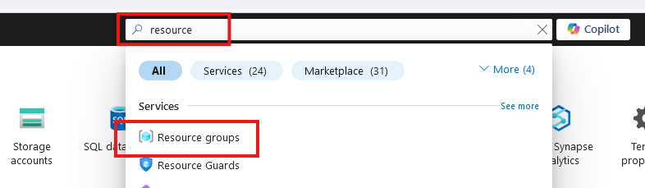
Create Resource Group

Slide 11
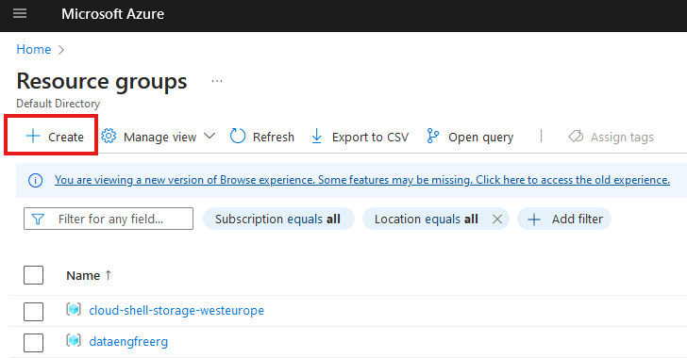
Create Resource Group

Slide 12
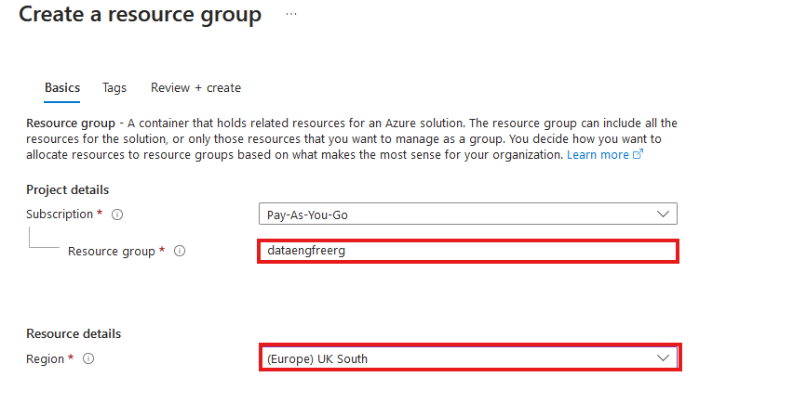
Create Resource Group

Slide 13
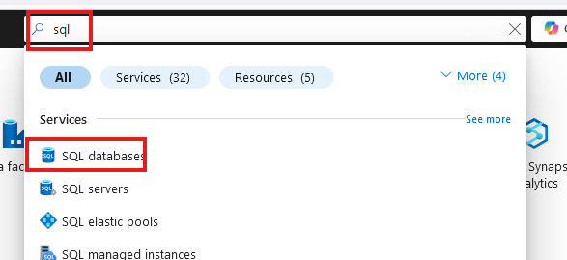
Create SQL database

Slide 14
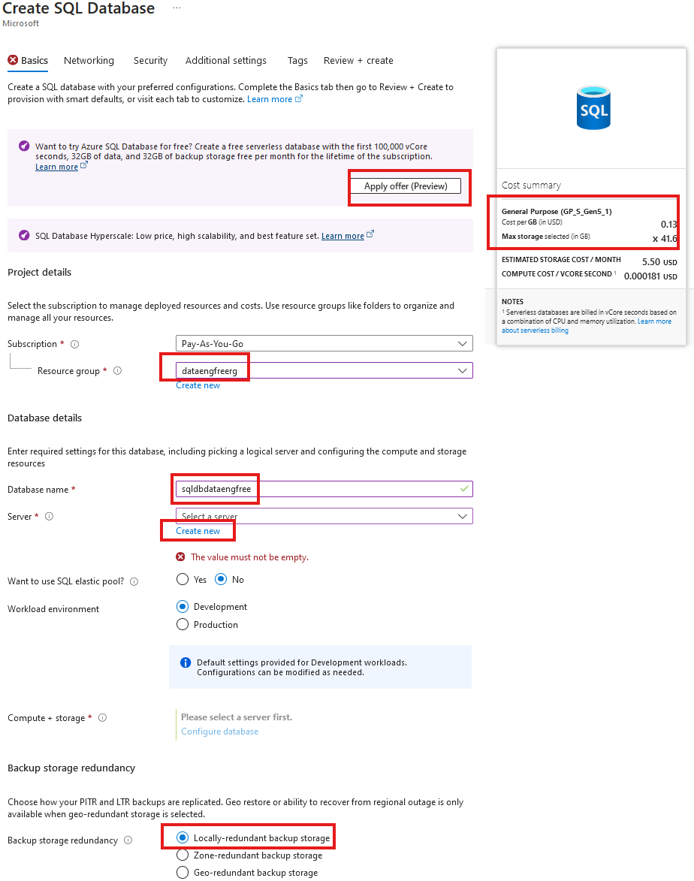
Create SQL database

Slide 15
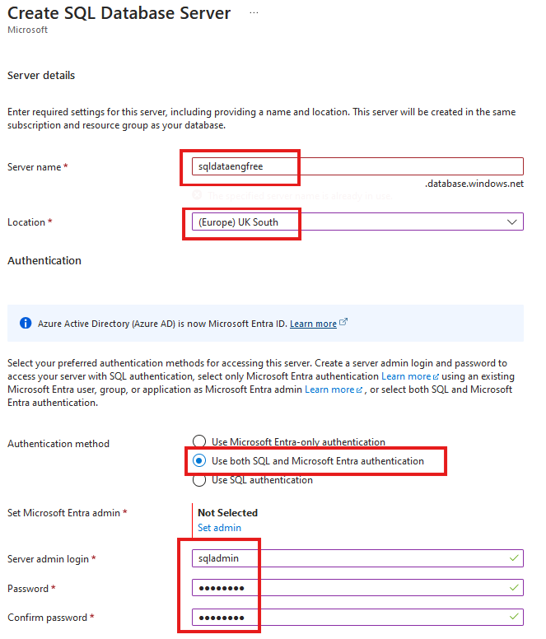
Create SQL database

Slide 16
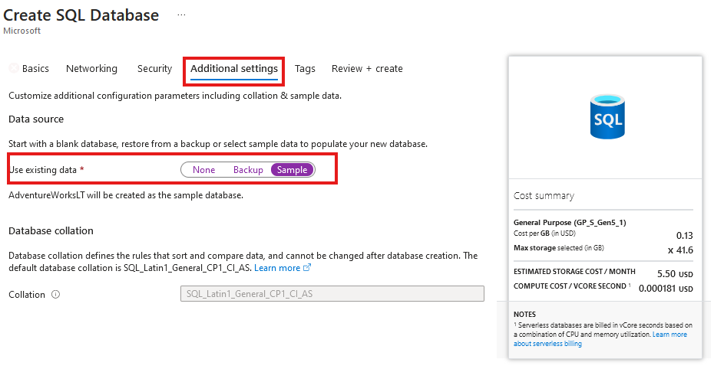
Create SQL database
Add sample data

Slide 17
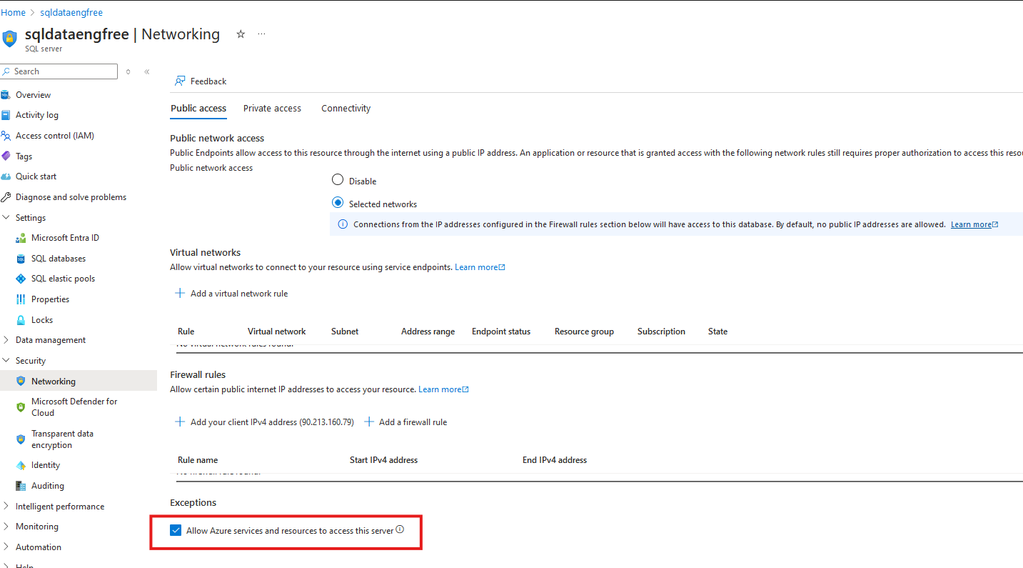

Slide 18
Azure CLI
Install by following links from: https://learn.microsoft.com/en-us/cli/azure/install-azure-cli
For VS Code:
Azure CLI Tools
Azure Developer CLI

Slide 19
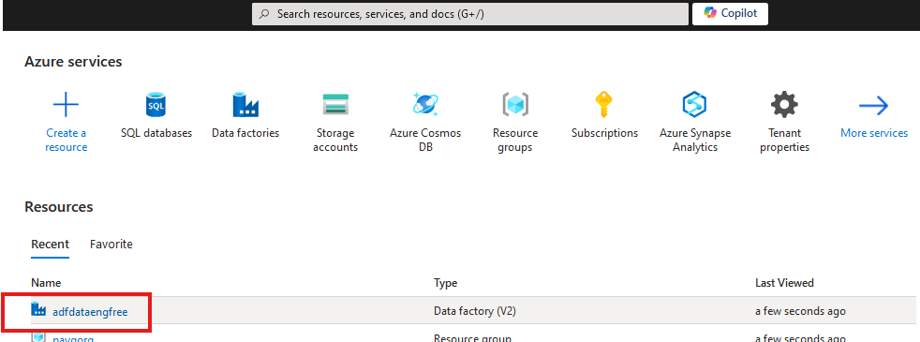
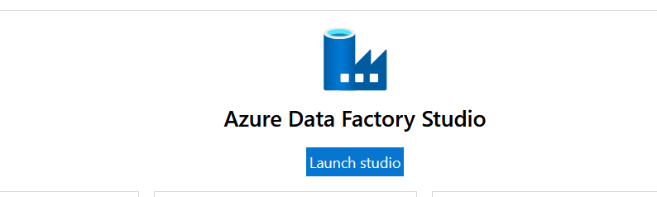

Slide 20
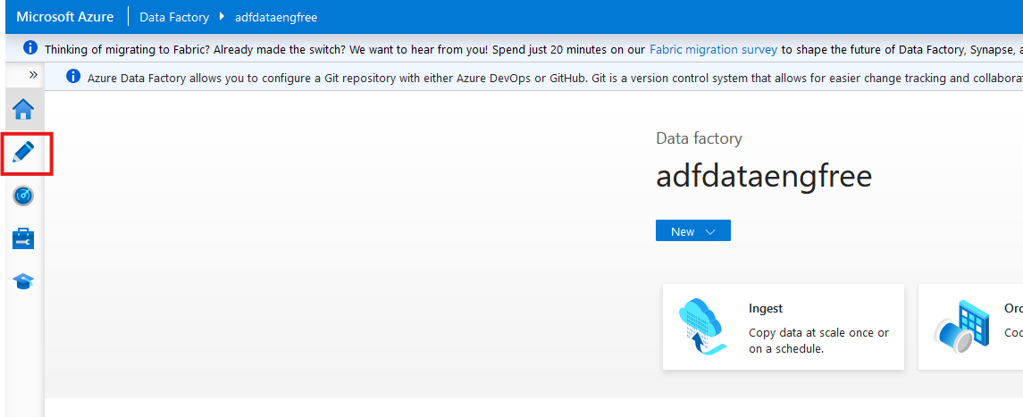

Slide 21
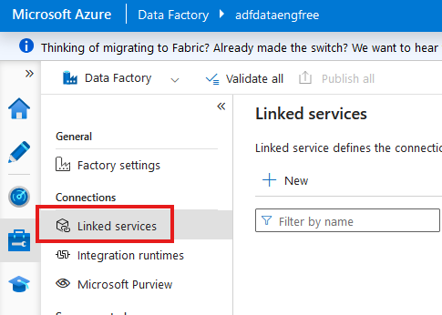

Slide 22
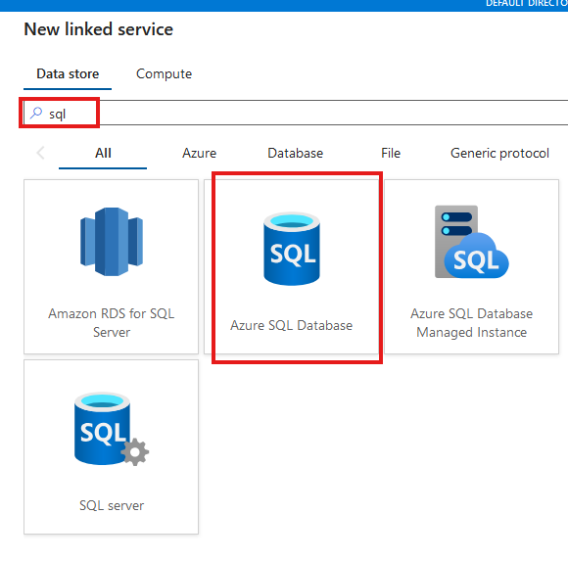

Slide 23
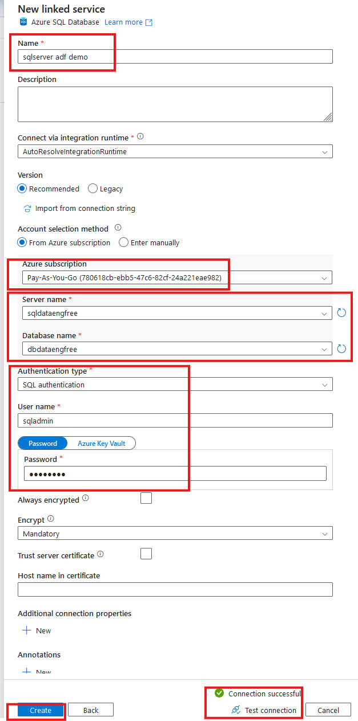

Slide 24
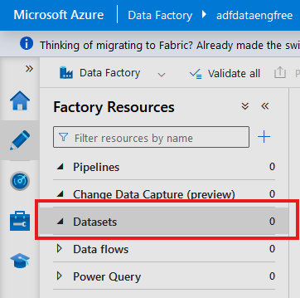
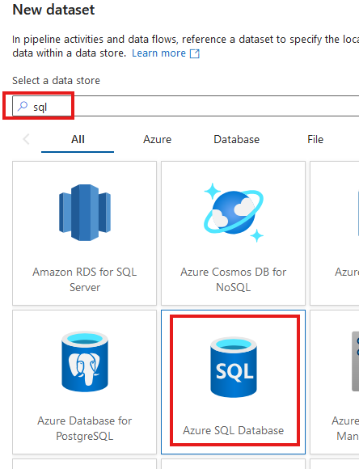

Slide 25
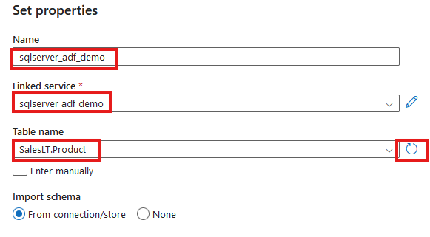

Slide 26
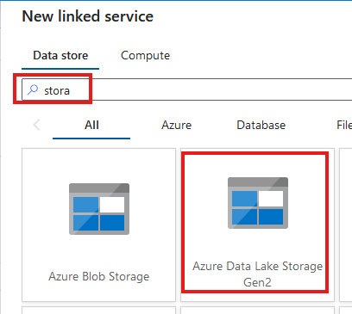
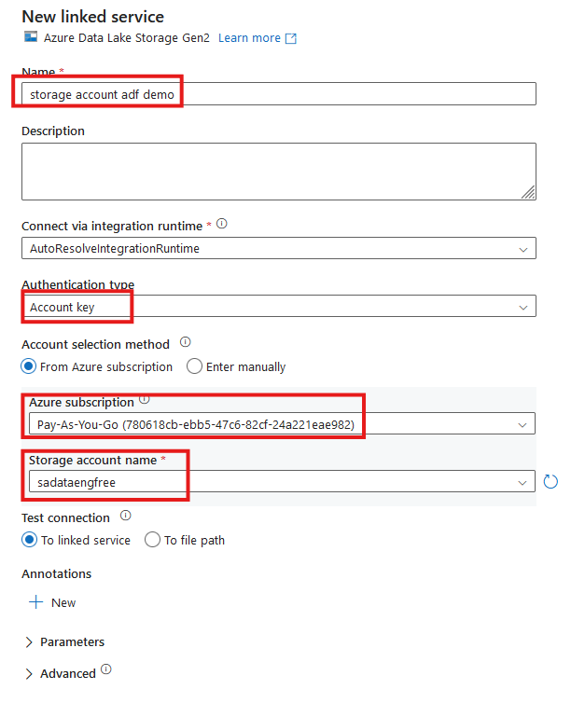


Slide 27
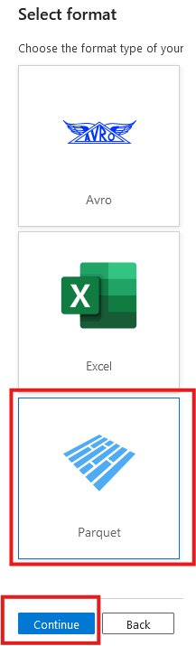
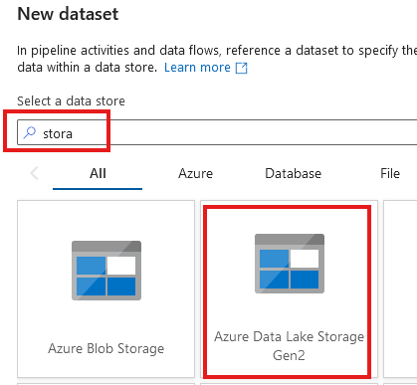

Slide 28
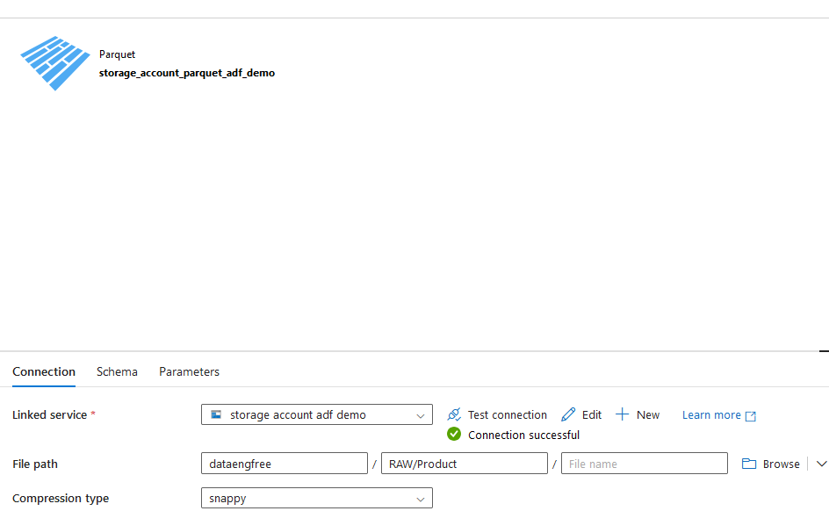

Slide 29
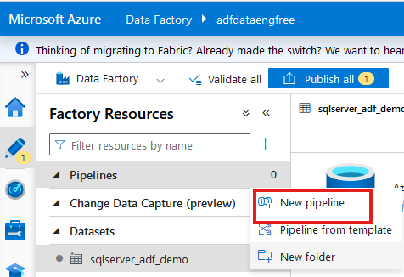
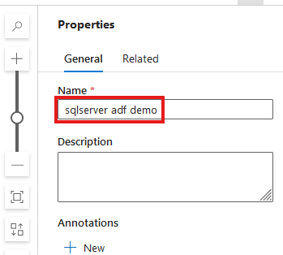

Slide 30
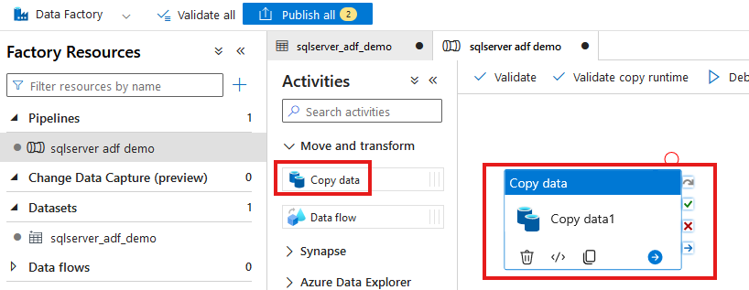

Slide 31
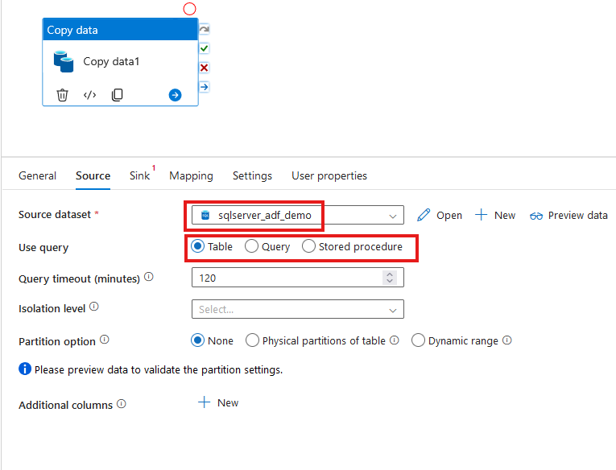

Slide 32
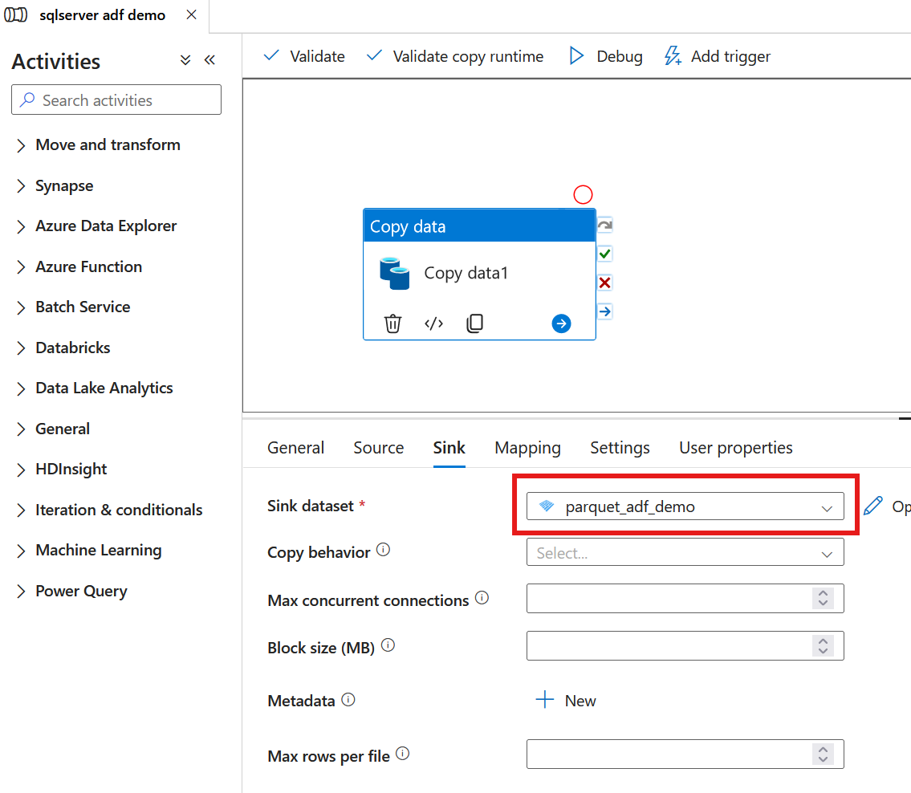

Slide 33
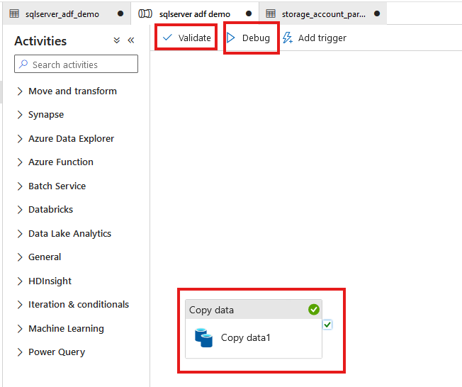

Slide 34
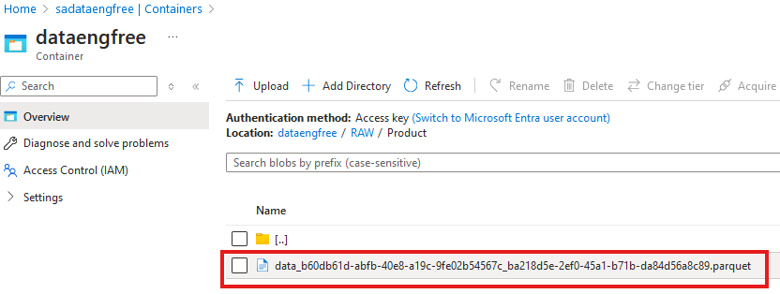

Slide 35
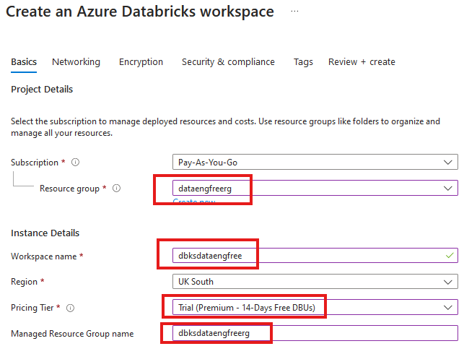


Slide 36
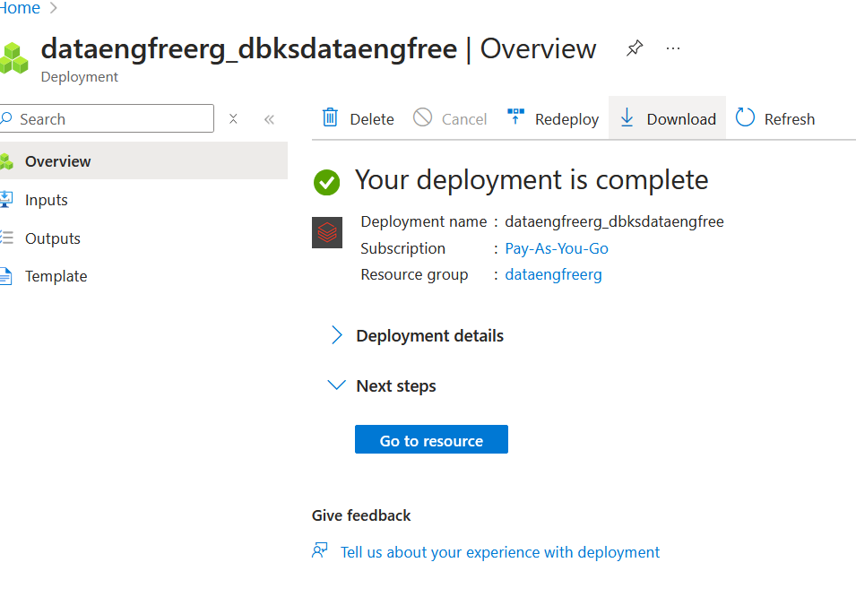

Slide 37
Azure CLI Part II

Slide 38
Databricks

Slide 39
Python
Use Anaconda
Use conda to create environment
Might need to enable Long Paths

Slide 40
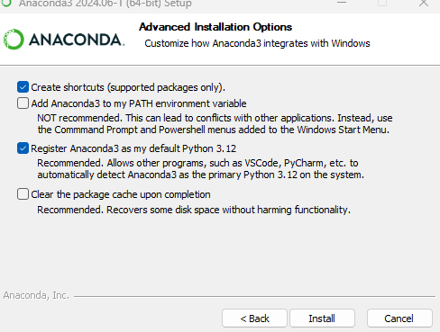
Anaconda install

Slide 41
Conda demo

Slide 42
PySpark Pre-requisites
Install Java (not v 21)
Set paths
JAVA_HOME
PATH
Install Apache Spark
Install winutils.exe
Create virtual environment
Instructions: https://sparkbyexamples.com/pyspark-tutorial/

Slide 43
PySpark Demo
Notes:
PySpark validation
Web UI
VS Code
- to run Jupiter notebooks needs ipykernel installed
- from vscode run conda install -n dataengforfree_env ipykernel
- copy python.exe > python3.exe
Visualisation?

Slide 44
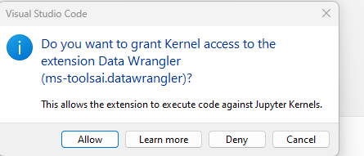

Slide 45
Follow-up Resources
Repo: https://github.com/phil-a10/Talks/tree/main/Data%20Engineering%20Using%20Free%20Tools
Microsoft Learn: https://learn.microsoft.com/en-us/training/career-paths/data-engineer
Kimball books
Downloads
Azure CLI: https://learn.microsoft.com/en-us/cli/azure/install-azure-cli

Slide 46
END

Slide 47
Azure CLI Demo

Slide 48
Create storage account
Create in same region as RG
Primary service is ADLS Gen 2
Primary workload Big Data Analytics
Performance: Standard
Redundancy: LRS
Add container > RAW directory

Slide 49
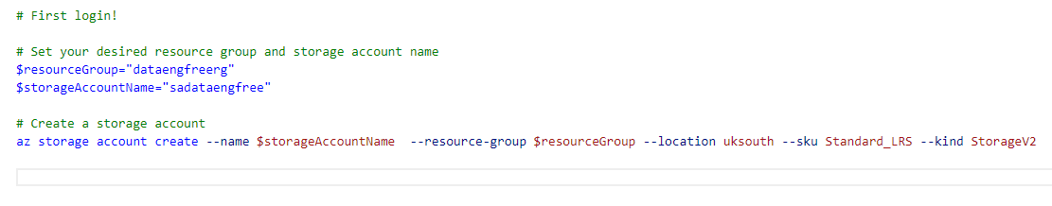
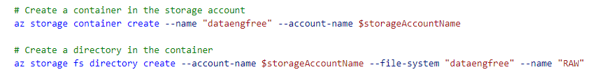
Create storage account

Slide 50
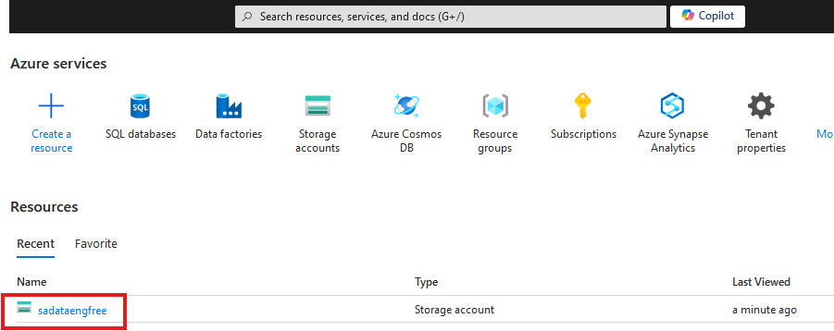

Slide 51
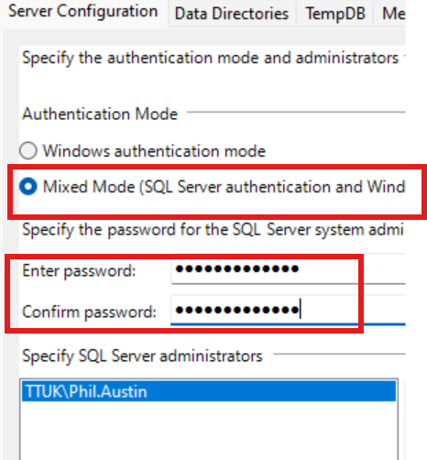

Slide 52
Create Azure Data Factory
Create in same region as RG

Slide 53
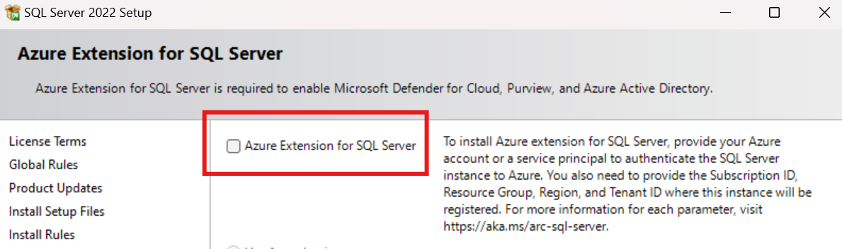
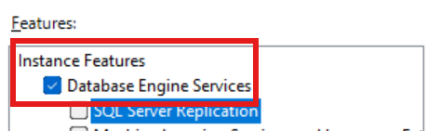
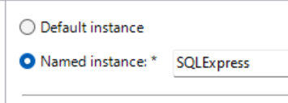

Slide 54
Data & Databases
Concepts to Learn: Data types, databases (SQL and NoSQL), data structures.
Tools/Resources:
Azure SQL Database - free tier available
Cosmos DB: Explore NoSQL databases with a limited free tier on Azure.

Slide 55
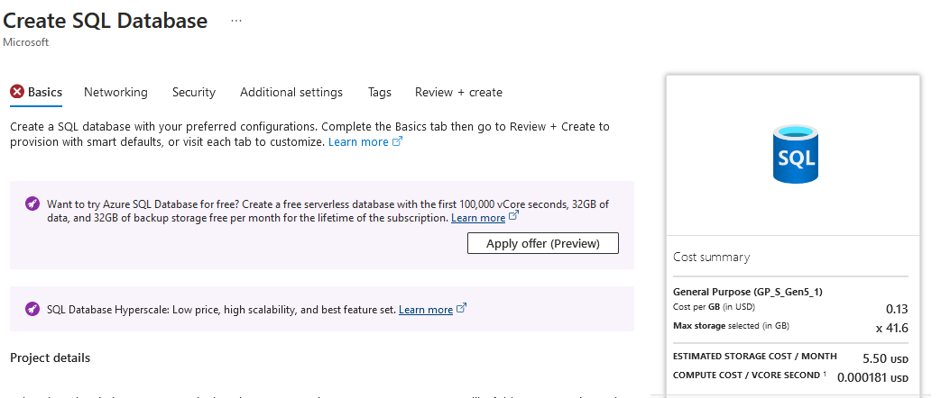

Slide 56
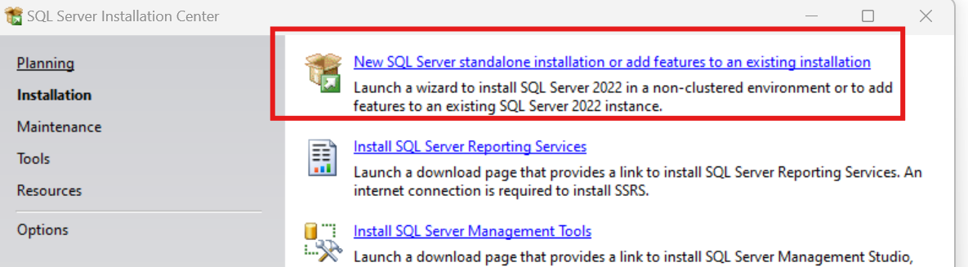
SQL Express!
https://www.microsoft.com/en-us/download/details.aspx?id=104781&lc=1033

Slide 57
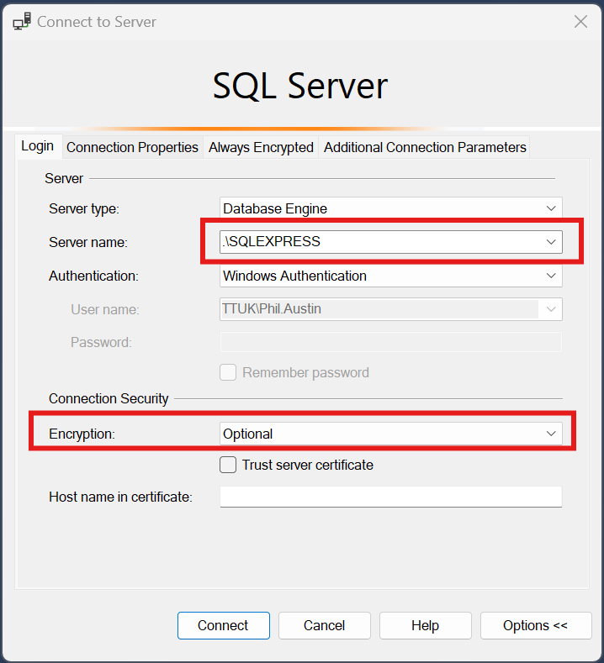

Slide 58
Download JDBC driver: https://repo1.maven.org/maven2/com/microsoft/azure/spark-mssql-connector_2.12/1.2.0/spark-mssql-connector_2.12-1.2.0.jar
Copy jar file to anaconda jars folder

Slide 59
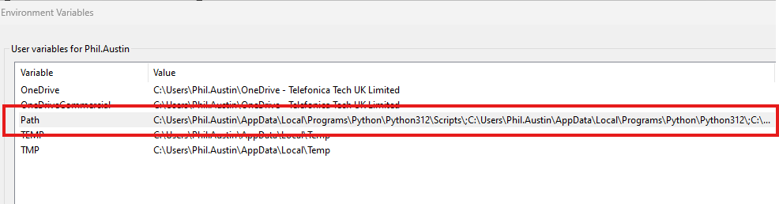
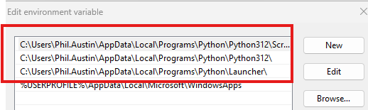
Python pre-reqs

Slide 60
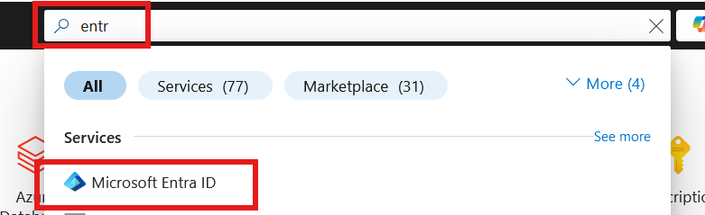
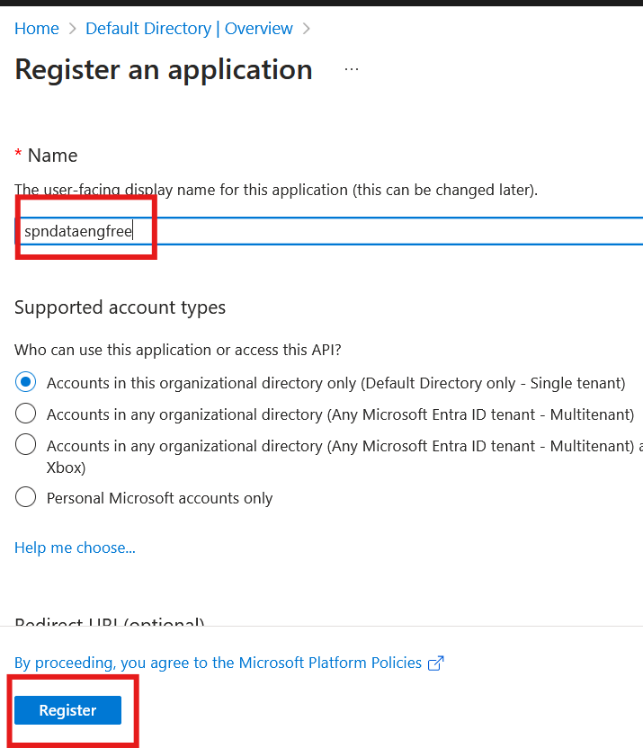

Slide 61
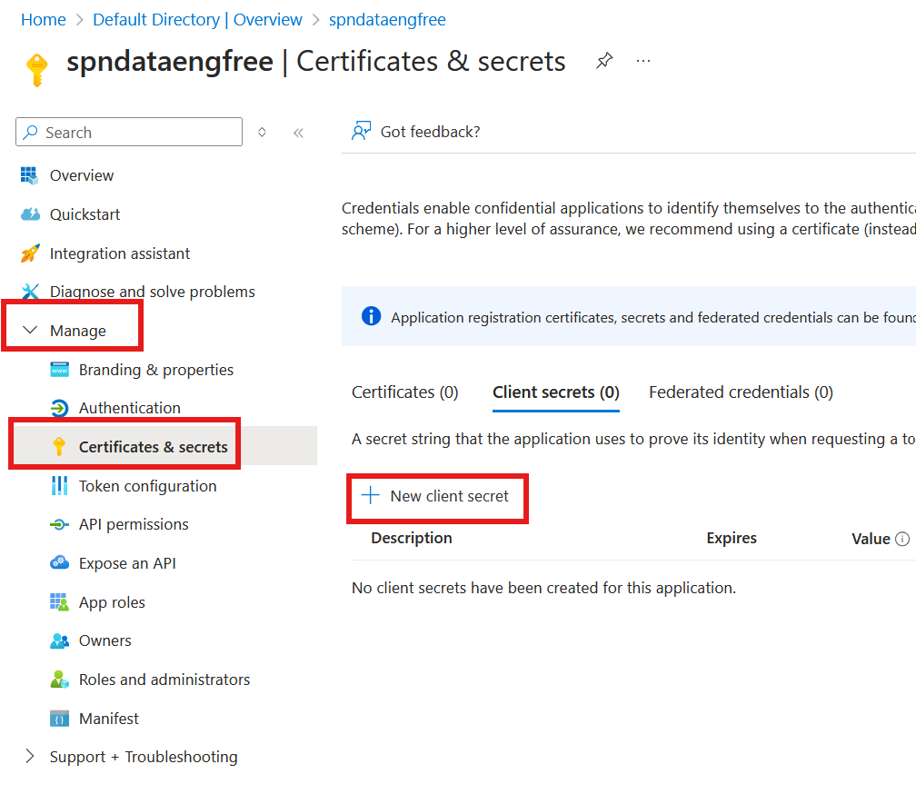
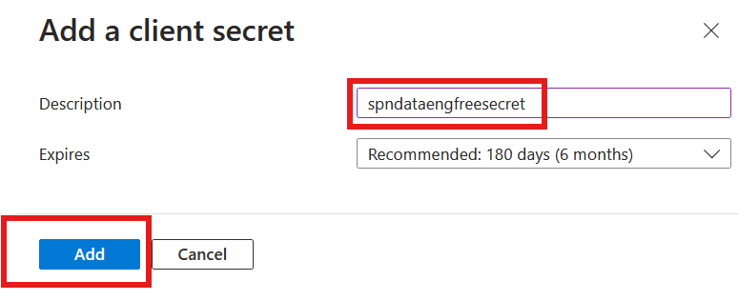

Slide 62



Slide 63


Slide 64

Create storage account

Slide 65

Create storage account

Slide 66

Create storage account

Slide 67



Slide 68


Create Azure Data Factory (ADF)

Slide 69
Create Azure Data Factory (ADF)

Slide 70

Create Azure Data Factory (ADF)

Slide 71


Slide 72


Slide 73


Slide 74


Slide 75


Slide 77
PySpark

